Slide 1
Exercise 7 (30 Minutes)
Design an object-oriented program for the following classes:
Geometry, Point, Line, Polygon, Triangle and Square.
This program should allow the construction of:
A point;
A line given two points;
A polygon, given 3 or more points;
A triangle, given 3 points;
A square, given its bottom left point and its side length.
These classes should implement the methods to get or compute (where and when appropriate): the name, the x, the y, the lines, and the area.
TIP: use the Shoelace Formula to compute the area of a triangle given 3 points.
Notes:
0

Slide 2
Solution
class Geometry: def __init__(self, name): self.__name = name def get_name(self): return self.__name class Point(Geometry): def __init__(self, name, x, y): super().__init__(name) self.__x = x self.__y = y def get_x(self): return self.__x def get_y(self): return self.__y
Notes:
1

Slide 3
Solution (II)
class Line(Geometry): def __init__(self, name, point_1, point_2): super().__init__(name) self.__point_1 = point_1 self.__point_2 = point_2 class Polygon(Geometry): def __init__(self, name, points): super().__init__(name) self.__points = points def get_points(self): return self.__points def lines(self): res = [] points = self.get_points() point_a = points[0] for point_b in points[1:]: res.append(Line(point_a.get_name() + '-' + point_b.get_name(), point_a, point_b)) point_a = point_b res.append(Line(point_a.get_name() + '-' + points[0].get_name(), point_a, points[0])) return res
Notes:
2

Slide 4
Solution (III)
class Triangle(Polygon): def __init__(self, name, point_1, point_2, point_3): super().__init__(name, [point_1, point_2, point_3]) def area(self): res = 0 ps = self.get_points() # Shoelace Formula res = res + ps[1].get_x() * ps[2].get_y() - ps[2].get_x() * ps[1].get_y() res = res - ps[0].get_x() * ps[2].get_y() + ps[2].get_x() * ps[0].get_y() res = res + ps[0].get_x() * ps[1].get_y() - ps[1].get_x() * ps[0].get_y() res = abs(res) / 2 return res
Notes:
3

Slide 5
Solution (IV)
class Square(Polygon): def __init__(self, name, bl_point, side): points = [bl_point, Point('top left point', bl_point.get_x(), bl_point.get_y() + side), Point('top right point', bl_point.get_x() + side, bl_point.get_y() + side), Point('bottom right point', bl_point.get_x() + side, bl_point.get_y())] super().__init__(name, points) self.__side = side def area(self): return self.__side ** 2
Notes:
4

Slide 6
Solution (V)
point_a = Point('A', 0, 0) point_b = Point('B', 0, 1) point_c = Point('C', 1, 1) triangle = Triangle('A', point_a, point_b, point_c) print('Lines of the triangle ' + triangle.get_name() + ':') for line in triangle.lines(): print(line.get_name()) print('Area:', triangle.area())
Notes:
5

Slide 7
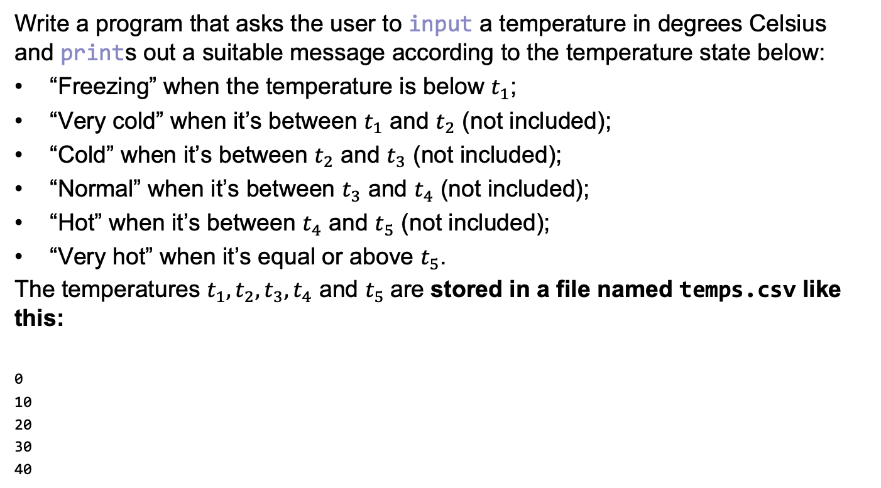
Exercise 8 (10 Minutes)
Write a program that asks the user to input a temperature in degrees Celsius and prints out a suitable message according to the temperature state below:
“Freezing” when the temperature is below $t_{1}$;
“Very cold” when it’s between $t_{1}$ and $t_{2}$ (not included);
“Cold” when it’s between $t_{2}$ and $t_{3}$ (not included);
“Normal” when it’s between $t_{3}$ and $t_{4}$ (not included);
“Hot” when it’s between $t_{4}$ and $t_{5}$ (not included);
“Very hot” when it’s equal or above $t_{5}$.
The temperatures $t_{1}, t_{2},t_{3},t_{4}$ and $t_{5}$are stored in a file named temps.csv like this:
0
10
20
30
40
Notes:
6

Slide 8
Solution
print('Temperature to Perceived Temperature Converter (0.4)') perceived_temps = ['freezing', 'very cold', 'cold', 'normal', 'hot', 'very hot'] temps = [] with open('temps.csv', 'r') as f: for line in f.readlines(): temp = float(line) temps.append(temp) temp = float(input('What temperature is outside? ')) perceived_temp = perceived_temps[-1] for i in range(len(temps)): if temp < temps[i]: perceived_temp = perceived_temps[i] break print('Your temperature today is', perceived_temp)
Notes:
7

